Slide 1
Adding interactivity to your Flutter app https://flutter.dev/docs/development/ui/interactive
Notes:
StatelessWidget is used for immutable elements that only rely on the object configuration information
StatefulWidget is used for elements that can dynamically change based on state-changes in the system
Everytime that state changes, setChange() is called by the object

Slide 2
What you’ll learn
How to respond to taps.
How to create a custom widget.
The difference between stateless and stateful widgets.

Slide 3
The building layouts tutorial showed you how to create the layout for the following screenshot.
The number next to the star indicates that 41 people have favorited this lake.
After completing this tutorial, tapping the star removes its favorited status, replacing the solid star with an outline and decreasing the count.
Tapping again favorites the lake, drawing a solid star and increasing the count.

Slide 4
Stateful and stateless widgets
A widget is either stateful or stateless.
A stateless widget never changes. Icon, IconButton, and Text are examples of stateless widgets.
A stateful widget is dynamic: for example, it can change its appearance in response to events triggered by user interactions or when it receives data. Checkbox, Radio, Slider, InkWell, Form, and TextField are examples of stateful widgets.

Slide 5
Creating a stateful widget
This section shows you how to build a stateful widget, called FavoriteWidget, for the lakes app.
After setting up, your first step is choosing how state is managed for FavoriteWidget.

Slide 6
Step 0: Get ready
Make sure you’ve set up your environment.
Create a basic “Hello World” Flutter app.
Replace the lib/main.dart file with main.dart.
Replace the pubspec.yaml file with pubspec.yaml.
Create an images directory in your project, and add lake.jpg.

Slide 7
Step 1: Decide which object manages the widget’s state
A widget’s state can be managed in several ways, but in our example the widget itself, FavoriteWidget, will manage its own state.
In this example, toggling the star is an isolated action that doesn’t affect the parent widget or the rest of the UI, so the widget can handle its state internally.

Slide 8
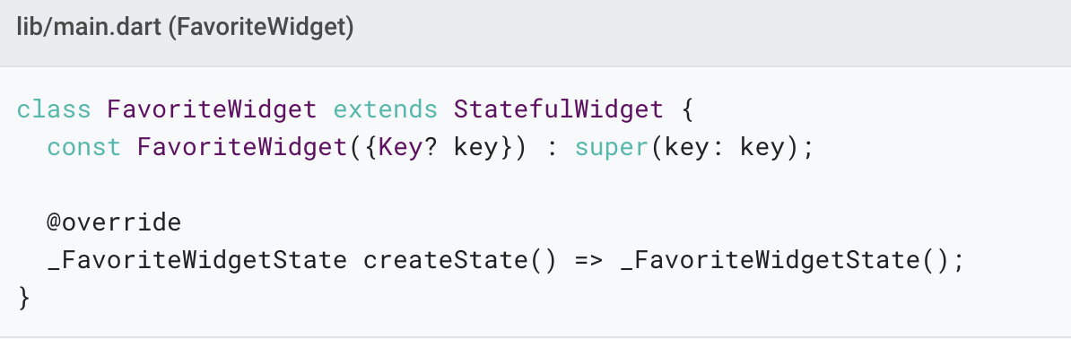
Step 2: Subclass StatefulWidget
The FavoriteWidget class manages its own state, so it overrides createState() to create a State object.

Slide 9
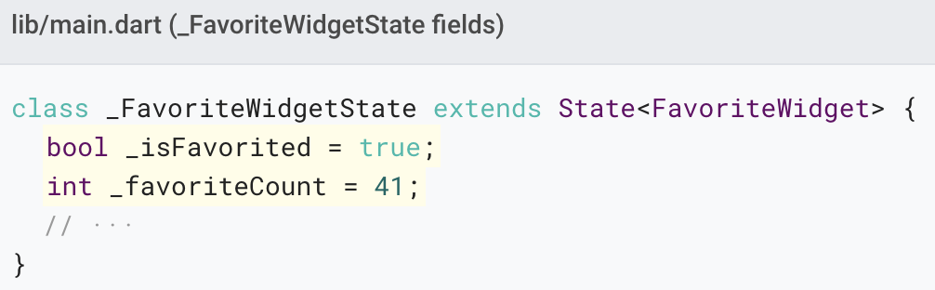
Step 3: Subclass State
The _FavoriteWidgetState class stores the mutable data that can change over the lifetime of the widget.

Slide 10
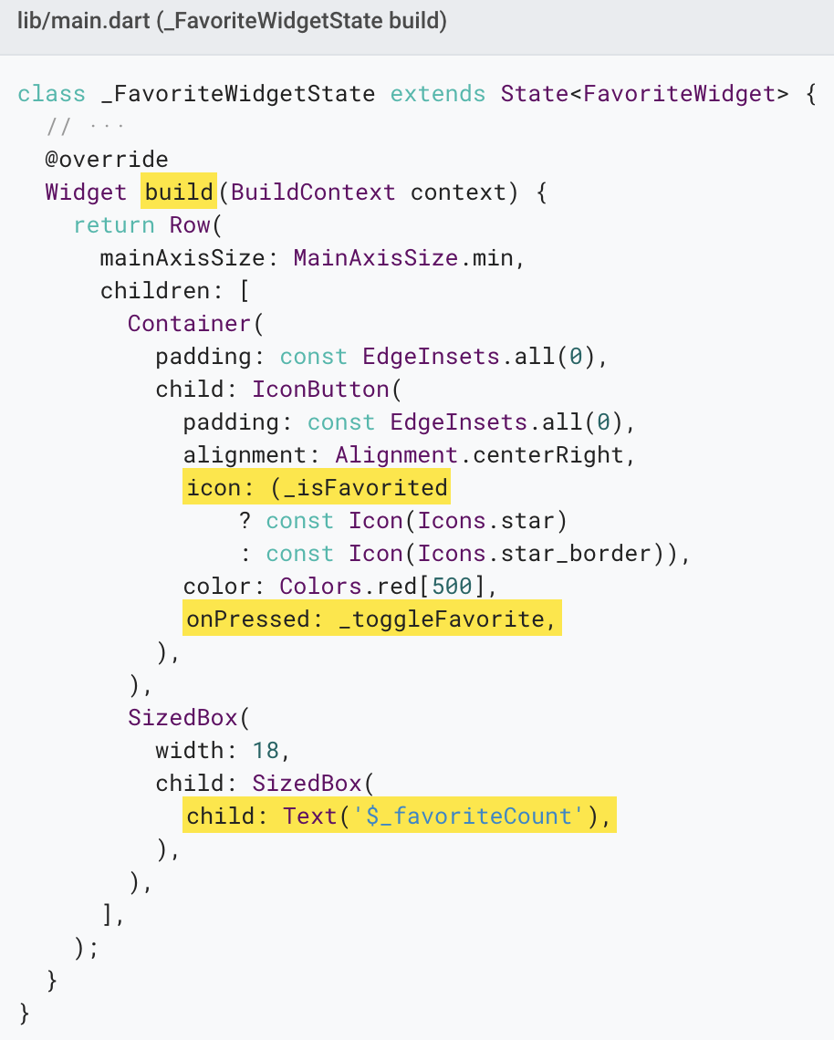
The class also defines a build() method, which creates a row containing a red IconButton, and Text.

Slide 11
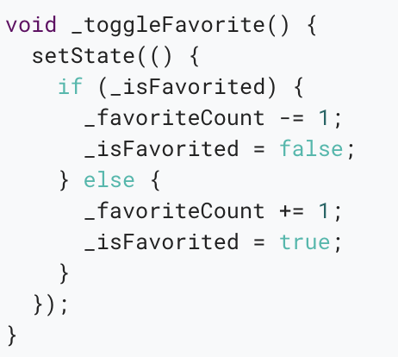
The _toggleFavorite() method, which is called when the IconButton is pressed, calls setState().

Slide 12
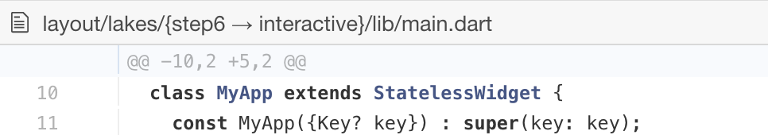
Step 4: Plug the stateful widget into the widget tree
Add your custom stateful widget to the widget tree in the app’s build() method.

Slide 13
Problems?
If you can’t get your code to run, look in your IDE for possible errors. Debugging Flutter apps might help.
If you still can’t find the problem, check your code against the interactive lakes example on GitHub.
lib/main.dart
pubspec.yaml
lakes.jpg

Slide 14
Other interactive widgets
Flutter offers a variety of buttons and similar interactive widgets.
Most of these widgets implement the Material Design guidelines, which define a set of components with an opinionated UI.
If you prefer, you can use GestureDetector to build interactivity into any custom widget.
You can find examples of GestureDetector in Managing state.

Slide 15
Material Components
Checkbox
DropdownButton
TextButton
FloatingActionButton
IconButton
Radio
ElevatedButton
Slider
Switch
TextField
Standard widgets
Form
FormField

Slide 16
Resources
Gestures, a section in the Flutter cookbook.
Handling gestures, a section in Introduction to widgets.
Gestures in Flutter.
Flutter API documentation.
Flutter Gallery running app, repo.
Flutter’s Layered Design (video).

Slide 17
Thank you!
Wenxuan Shi
College of Software, Nankai University
Email: shiwx@nankai.edu.cn
Wechat: 13920561100

